Slide 1
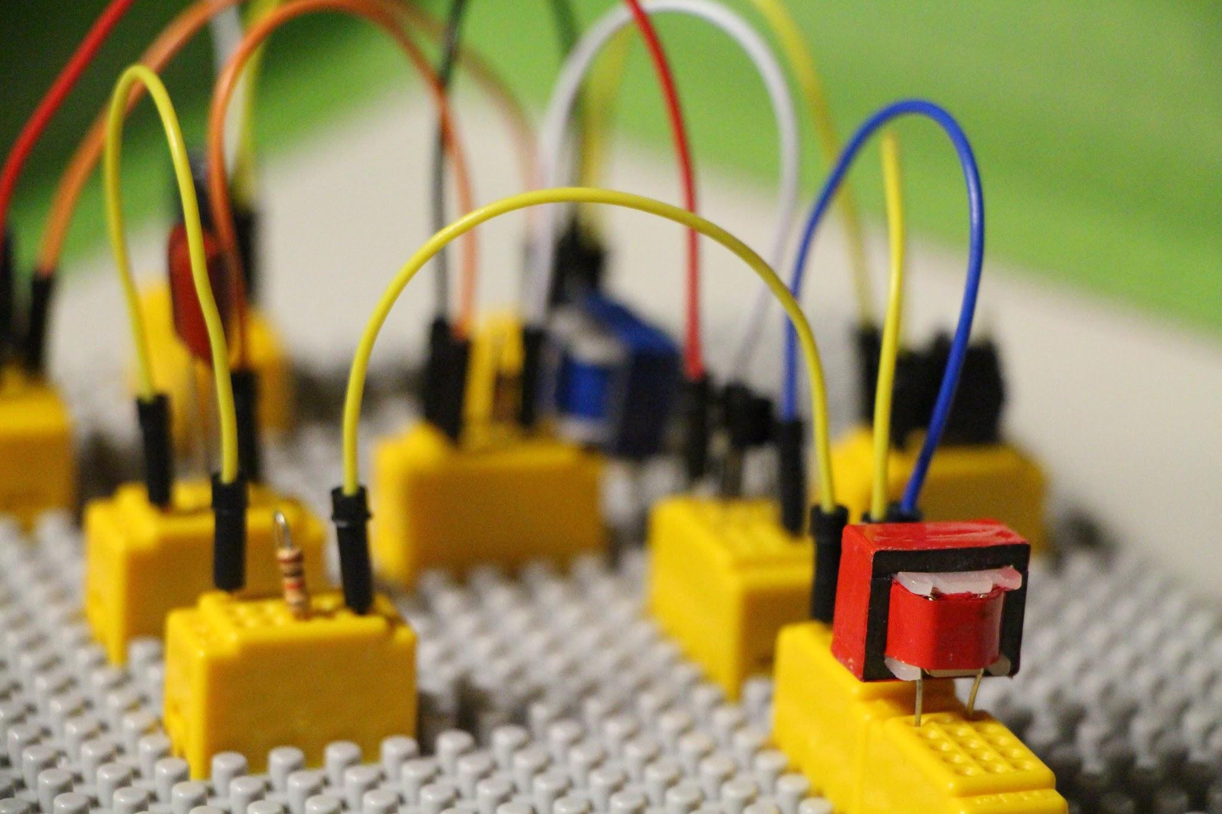
Arduino
Parking
Sensor
Christian Tucker-Allen, Kanan Ibadzade,
Alan Sandoval, Zhibin Lin, Efe Gur and Samson otu
Engineering E10
De Anza College
Professor Saied Rafati
Group 3
5-15-2024

Slide 2
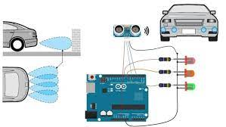
Why is it needed?
Safety First
Protecting the Investment
Old Transportations
Parking sensors help prevent accidents by alerting you to obstacles you might not see, like low walls, posts, or even small children.
Parking sensors can help prevent minor or major damage, saving you money on repairs in the long run.
Do you have old car that doesn’t have screen, backup or turning camera that helps to see blind spots?
Notes:
Kanan

Slide 3
What does it do?
Ultrasonic Sensor
The Arduino parking sensor detects obstacles within a 15° angle and up to 4 meters (400 cm) away. It uses an ultrasonic sensor to measure distance and provides feedback via an acoustic signal. When an object is closer than 100 cm, the sensor activates a beeping sound.
This sensor is the key component. It sends out high-frequency sound waves that bounce off objects ,and return to the sensor. The time taken for the waves to return is used to calculate the distance to the object.
Arduino Microcontroller
BuzzerTH
The brain of the system, the Arduino, processes the data from the ultrasonic sensor. It calculates the distance and determines how the system should respond.
This is the main alert mechanism. The Arduino controls the buzzer to beep at different rates depending on the distance to the obstacle. A faster beep means you’re getting closer, and a continuous beep means stop immediately.
Notes:
Efe / Samson

Slide 4
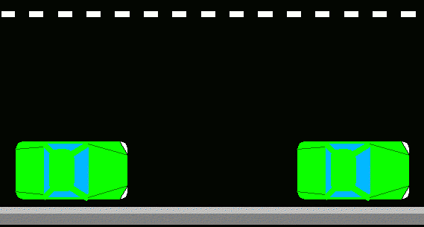
What are the similarities with existing products?
The sensor will detect how close it is to objects, both animate and inanimate, in its vicinity.
The closer the object, the quicker it will beep.
Will be positioned near the corners of the vehicle.
Notes:
Christian

Slide 5
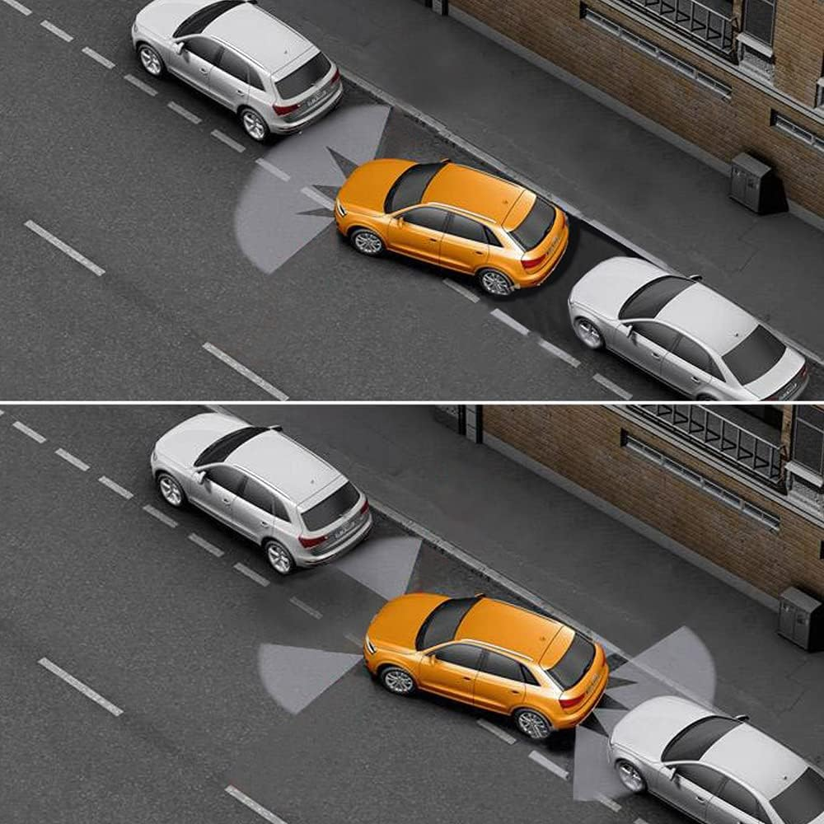
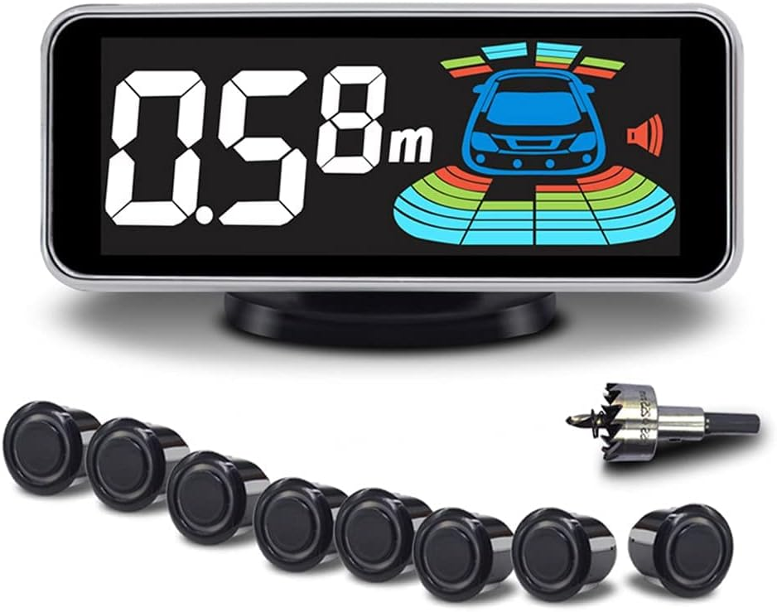
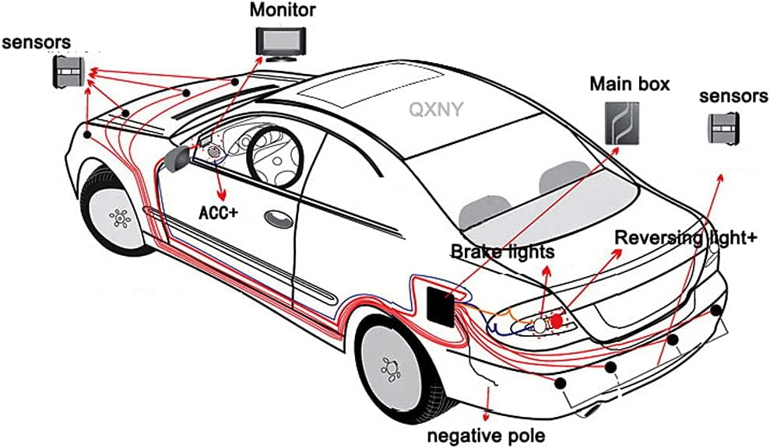
What are added features/enhancements with existing products?
Existing products: 8 Parking Sensors Kit with LCD Distance Display
Multiple Sensors and multiple directions detect
Multiple ways to warn
Water and dustproof sensor
Low price
Notes:
Zhibin

Slide 6

Is it really needed?

Slide 7
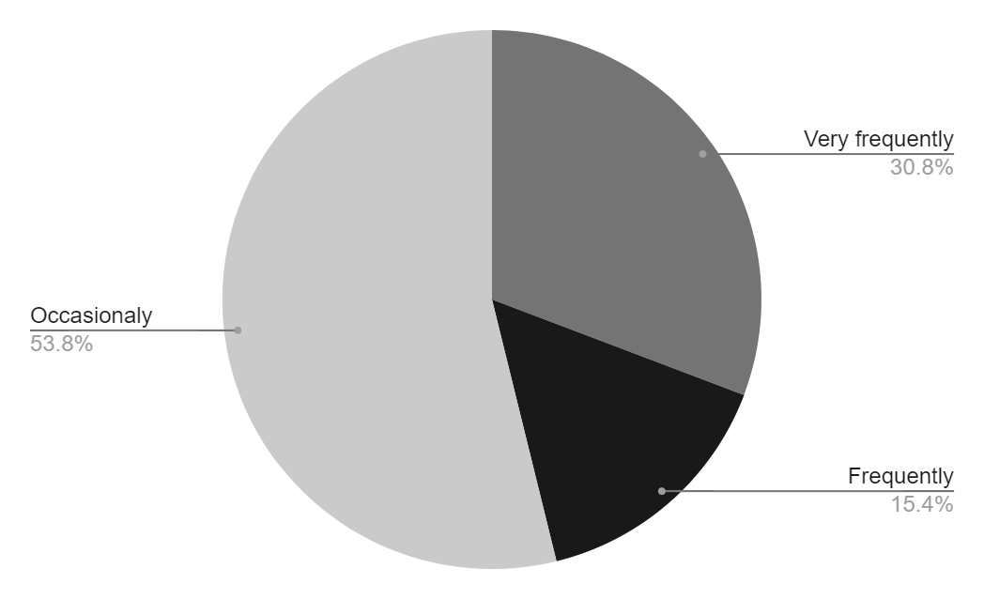
Survey Data - Parking
13 Surveyees
Found difficulty in parking

Slide 8
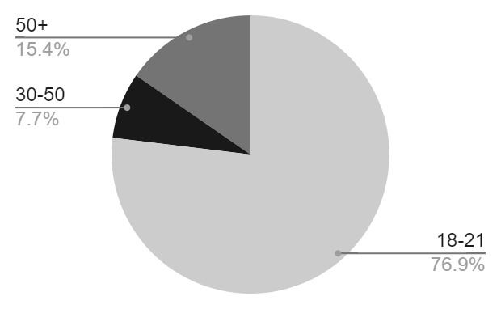
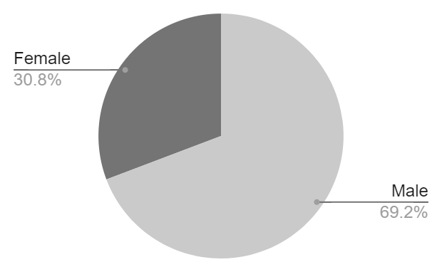
Survey Demographics
13 Surveyees
Age
Gender

Slide 9
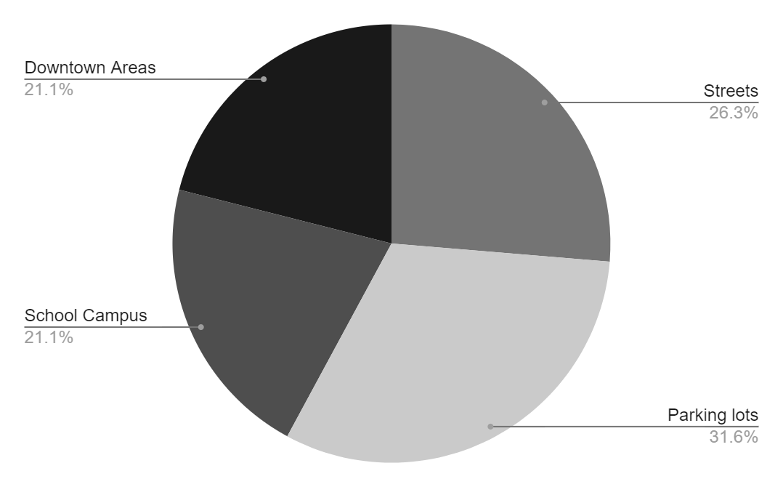
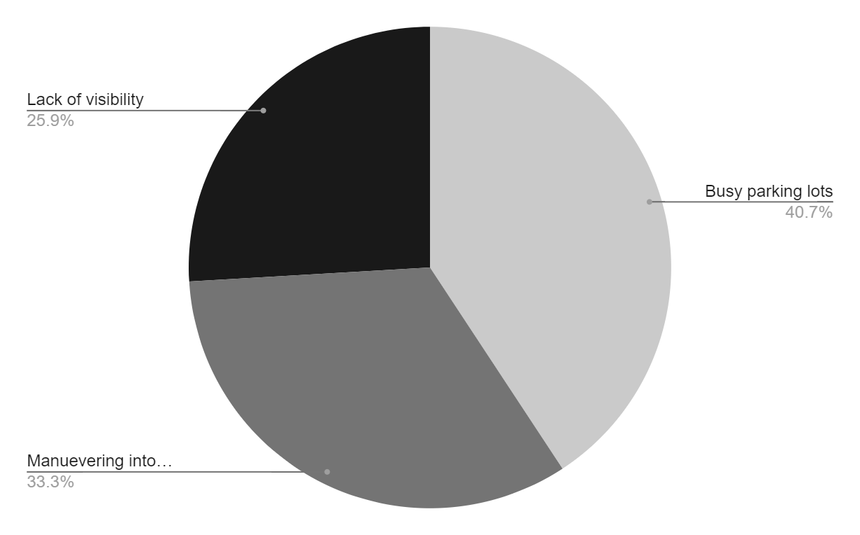
Survey Data - Where & Why?
13 Surveyees
Specific Areas
Common Factors

Slide 10
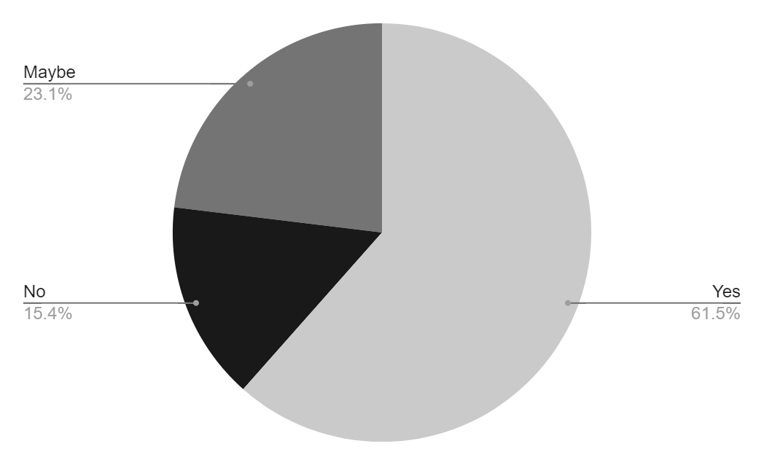
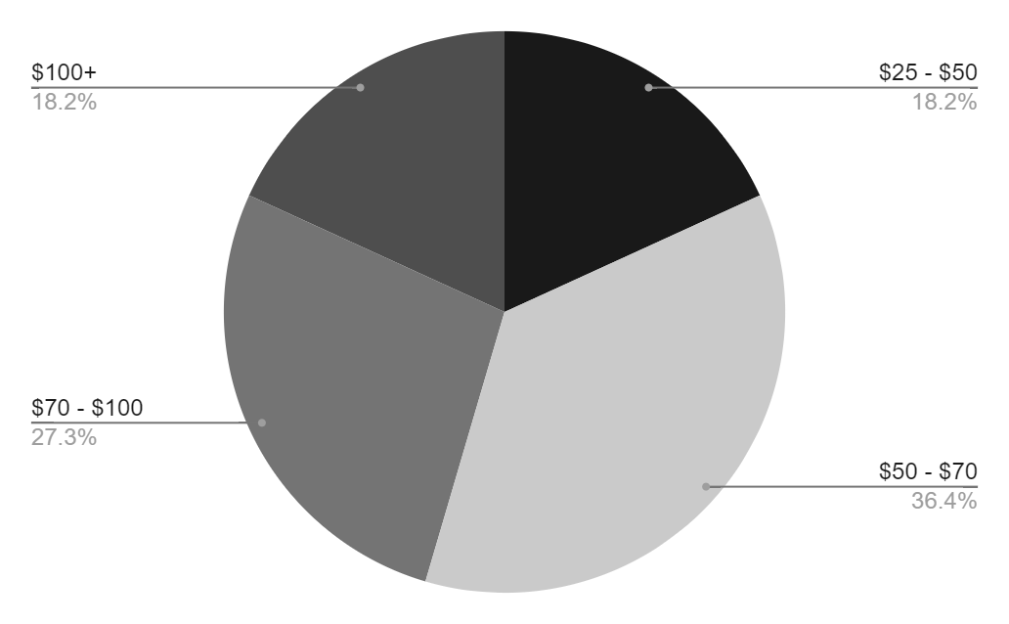
Survey Data - Pricing?
13 Surveyees
Considered Purchasing
Bid Price
Average: $91.14

Slide 11
Parts Order Status
ITEMS | PRICE | QUANTITY | DELIVERY STATUS | SHIPPING COST | COST PER ITEM
Ultrasonic Sensor | $6.99 | 1 | Shipping | $0 | $6.99
Arduino UNO | $14.99 | 1 | Shipping | $0 | $14.99
Jumper Wires | $3.99 | 1 Pack | Shipping | $0 | $3.99
Bread board | $5.99 | 1 | Shipping | $0 | $5.99
LED Light | $4.99 | 1 | Shipping | $0 | $4.99
Buzzer | $6.99 | 1 | Shipping | $0 | $6.99
Total Cost | $44

Slide 12

Is it really needed?

Slide 13
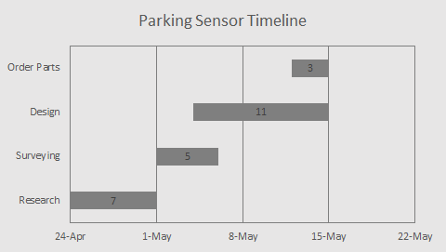
Parking Sensor Gantt Chart

Slide 14
Thank You!
Any Questions?

